Slide 1
Performance-Driven Composite Prefetching with Bandits
Charles Block, Pedro Palacios Almendros, Abraham Farrell, Gerasimos Gerogiannis, Josep Torrellas
University of Illinois Urbana-Champaign
coblock2@illinois.edu
February 1, 2026

Slide 2
Prefetching Feedback Mechanisms
Many prefetchers collect feedback to tune their actions
Pythia and Berti both use accuracy/timeliness information
Complex relationship between heuristics and performance
Tradeoff between accuracy and coverage changes between workloads
Individual prefetchers struggle to use performance as feedback
Performance is a very coarse-grained metric
Prefetchers must make fine-grained decisions (stride offsets, etc.)

Slide 3
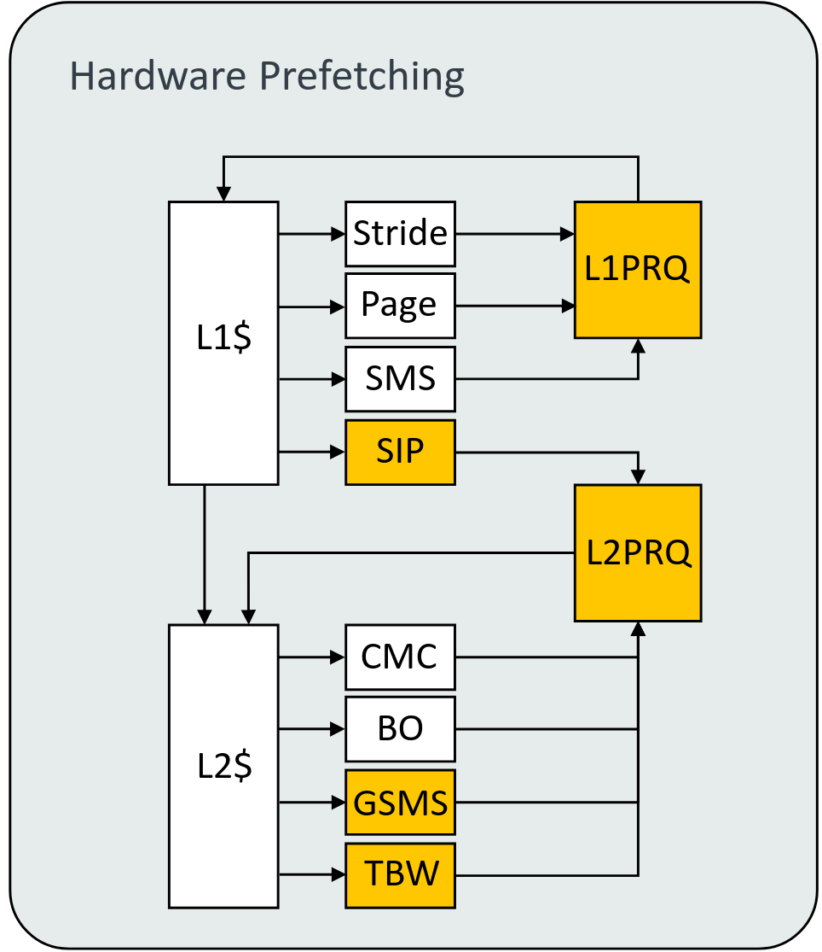
Ensembles of Prefetchers
Extract the benefits of many types of prefetchers
Offers coarse-grained decisions
Which prefetchers should be active in a workload?
Which prefetchers should be prioritized?
Performance-driven control becomes feasible
"Arm Neoverse V2 platform", Hot Chips 2023

Slide 4
Multi-Armed Bandits

Slide 5
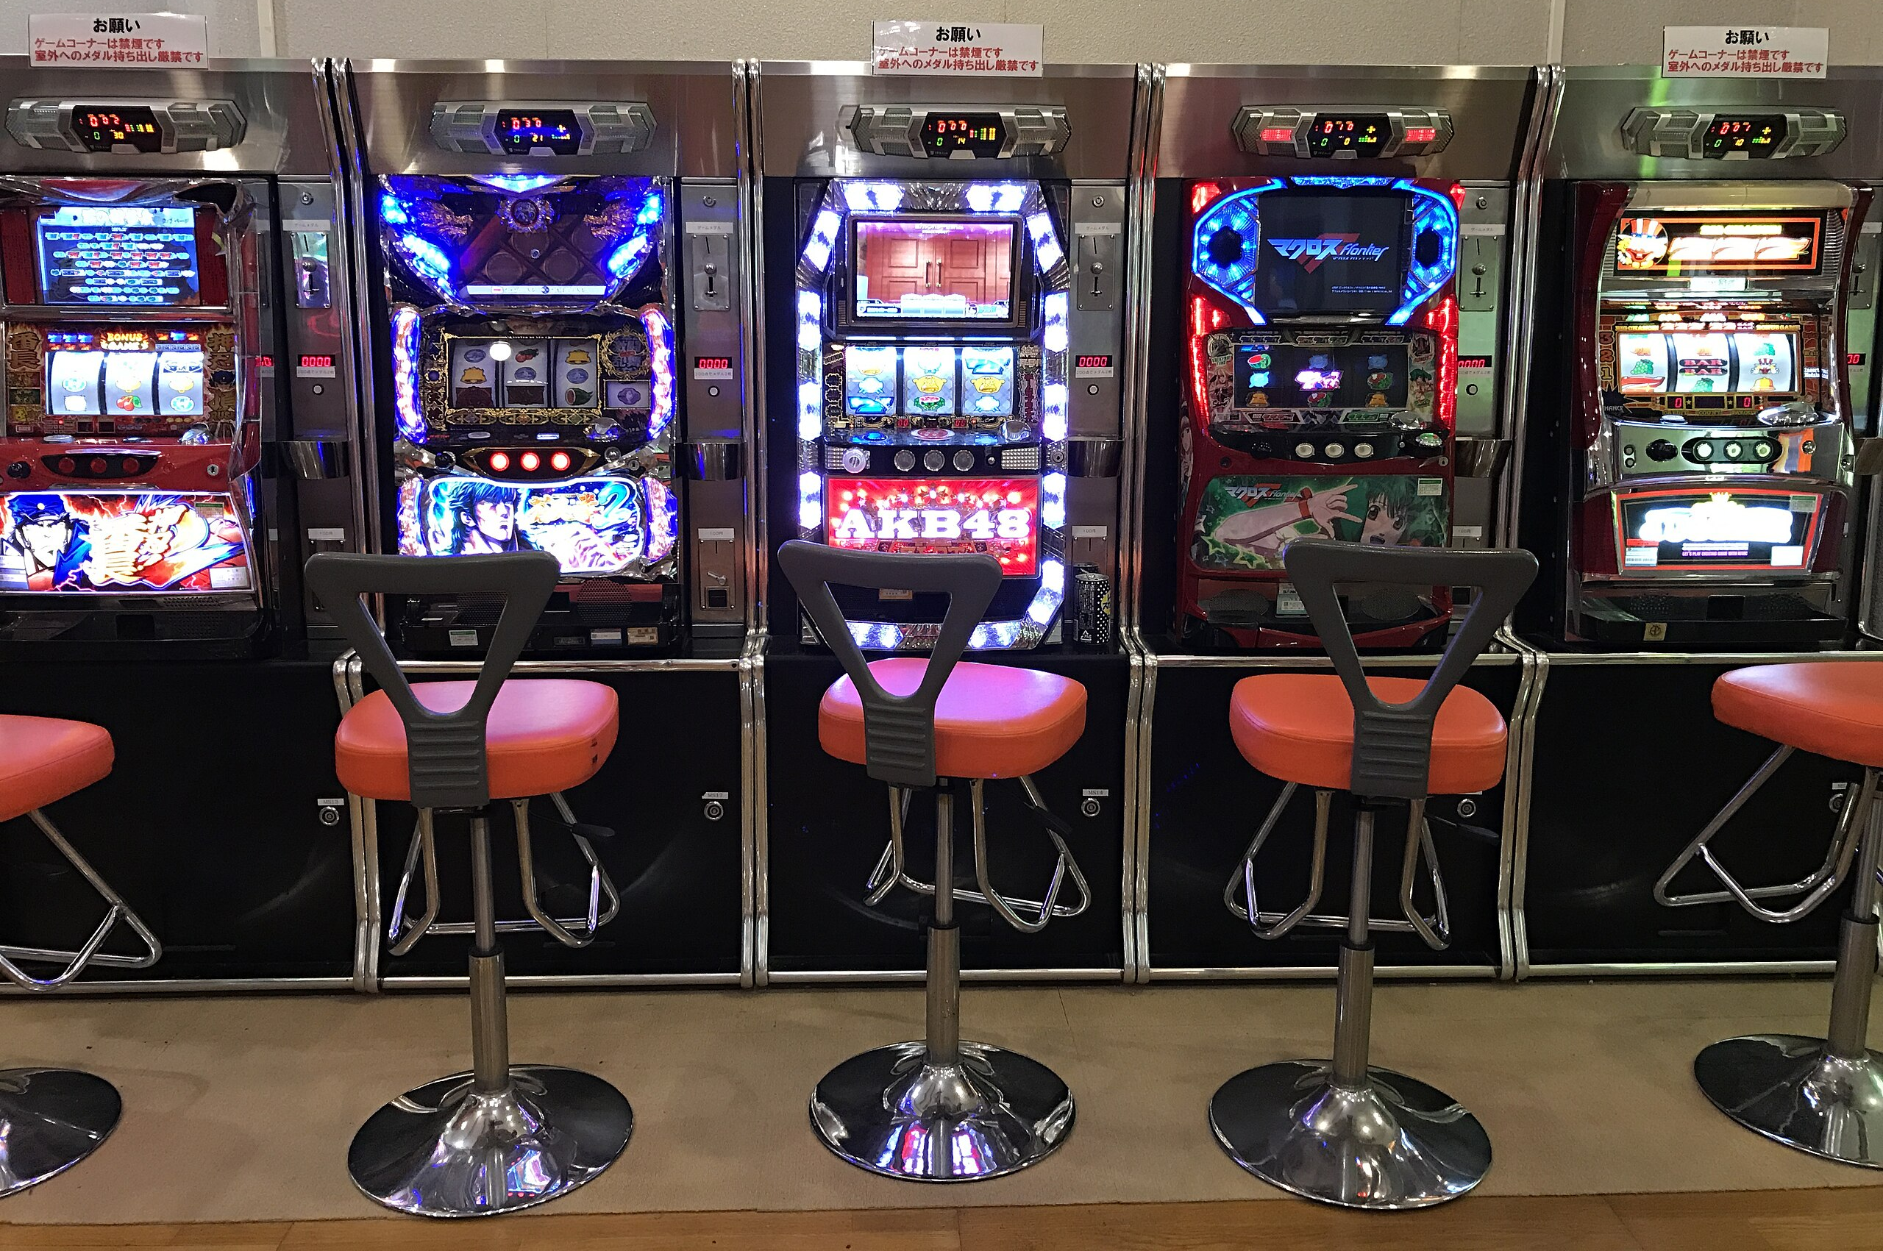
Multi-Armed Bandits
Which machine pays out most?

Slide 6
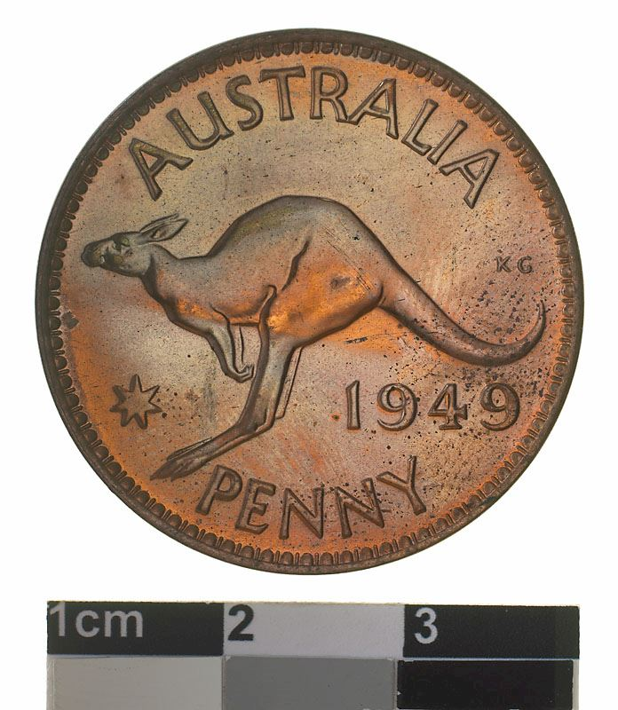
Multi-Armed Bandits
Images by bizmac - IMG_7080, CC BY 2.0, https://commons.wikimedia.org/w/index.php?curid=54615179; and by Naomi Andrzejeski - https://commons.wikimedia.org/wiki/File:Proof_Coin_-_1_Penny,_Australia,_1949.jpg

Slide 7
Multi-Armed Bandits
1
0
3
0
2
Images by bizmac - IMG_7080, CC BY 2.0, https://commons.wikimedia.org/w/index.php?curid=54615179; and by Naomi Andrzejeski - https://commons.wikimedia.org/wiki/File:Proof_Coin_-_1_Penny,_Australia,_1949.jpg

Slide 8
Multi-Armed Bandits
1
0
3
0
2
Images by bizmac - IMG_7080, CC BY 2.0, https://commons.wikimedia.org/w/index.php?curid=54615179; and by Naomi Andrzejeski - https://commons.wikimedia.org/wiki/File:Proof_Coin_-_1_Penny,_Australia,_1949.jpg

Slide 9
Multi-Armed Bandits
1
0
3
0
2
Images by bizmac - IMG_7080, CC BY 2.0, https://commons.wikimedia.org/w/index.php?curid=54615179; and by Naomi Andrzejeski - https://commons.wikimedia.org/wiki/File:Proof_Coin_-_1_Penny,_Australia,_1949.jpg

Slide 10
Multi-Armed Bandits
1
0
1.5
0
2
Images by bizmac - IMG_7080, CC BY 2.0, https://commons.wikimedia.org/w/index.php?curid=54615179; and by Naomi Andrzejeski - https://commons.wikimedia.org/wiki/File:Proof_Coin_-_1_Penny,_Australia,_1949.jpg

Slide 11
Multi-Armed Bandits
1
0
1.5
0
2
Images by bizmac - IMG_7080, CC BY 2.0, https://commons.wikimedia.org/w/index.php?curid=54615179; and by Naomi Andrzejeski - https://commons.wikimedia.org/wiki/File:Proof_Coin_-_1_Penny,_Australia,_1949.jpg

Slide 12
Multi-Armed Bandits
1
0
1.5
0
2
Images by bizmac - IMG_7080, CC BY 2.0, https://commons.wikimedia.org/w/index.php?curid=54615179; and by Naomi Andrzejeski - https://commons.wikimedia.org/wiki/File:Proof_Coin_-_1_Penny,_Australia,_1949.jpg

Slide 13
Multi-Armed Bandits
1
0
1.5
0
2.5
Images by bizmac - IMG_7080, CC BY 2.0, https://commons.wikimedia.org/w/index.php?curid=54615179; and by Naomi Andrzejeski - https://commons.wikimedia.org/wiki/File:Proof_Coin_-_1_Penny,_Australia,_1949.jpg

Slide 14
Micro-Armed Bandit for Prefetching
Stream
Stream
Stream
Stream
Stream
Stride
Stride
Stride
Stride
Stride
SMS
SMS
SMS
SMS
SMS
1
0
1.5
0
2.5
Images by bizmac - IMG_7080, CC BY 2.0, https://commons.wikimedia.org/w/index.php?curid=54615179; and by Naomi Andrzejeski - https://commons.wikimedia.org/wiki/File:Proof_Coin_-_1_Penny,_Australia,_1949.jpg

Slide 15
Micro-Armed Bandit for Prefetching
Stream
Stream
Stream
Stream
Stream
Stride
Stride
Stride
Stride
Stride
SMS
SMS
SMS
SMS
SMS
IPC=2.55
1
0
1.5
0
2.5

Slide 16
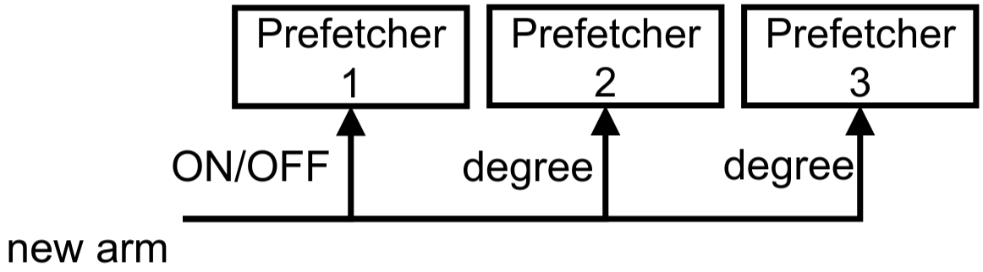
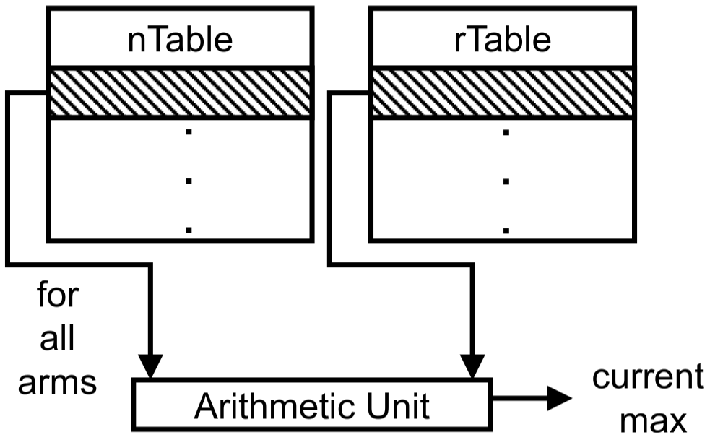
Micro-Armed Bandit for Prefetching
Gerogiannis & Torrellas, "Micro-Armed Bandit: Lightweight & Reusable Reinforcement Learning for Microarchitecture Decision-Making," Micro 2023

Slide 17
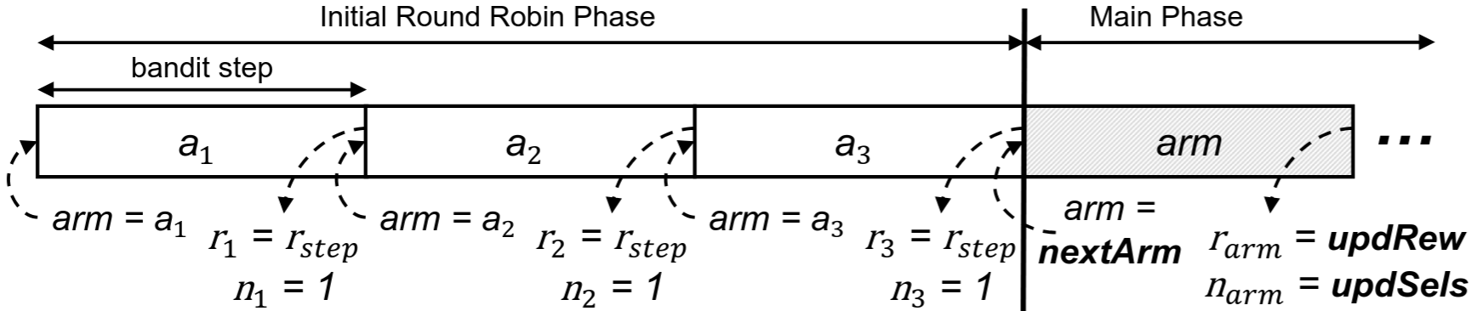
Micro-Armed Bandit for Prefetching
Gerogiannis & Torrellas, "Micro-Armed Bandit: Lightweight & Reusable Reinforcement Learning for Microarchitecture Decision-Making," Micro 2023

Slide 18
Micro-Armed Bandit for Prefetching
Gerogiannis & Torrellas, "Micro-Armed Bandit: Lightweight & Reusable Reinforcement Learning for Microarchitecture Decision-Making," Micro 2023

Slide 19
Micro-Armed Bandit for Prefetching
Gerogiannis & Torrellas, "Micro-Armed Bandit: Lightweight & Reusable Reinforcement Learning for Microarchitecture Decision-Making," Micro 2023

Slide 20
Micro-Armed Bandit for Prefetching
Gerogiannis & Torrellas, "Micro-Armed Bandit: Lightweight & Reusable Reinforcement Learning for Microarchitecture Decision-Making," Micro 2023

Slide 21
The Multi-Core Problem

Slide 22
The Multi-Core Problem
CPU
CPU
CPU
CPU
L2
RL
L2
RL
L2
RL
L2
RL
LLC
Memory
Block et al., "Micro-MAMA: Multi-Agent Reinforcement Learning for Multicore Prefetching," Micro 2025

Slide 23
The Multi-Core Problem
CPU
CPU
CPU
CPU
L2
RL
L2
RL
L2
RL
L2
RL
LLC
Memory
Block et al., "Micro-MAMA: Multi-Agent Reinforcement Learning for Multicore Prefetching," Micro 2025

Slide 24
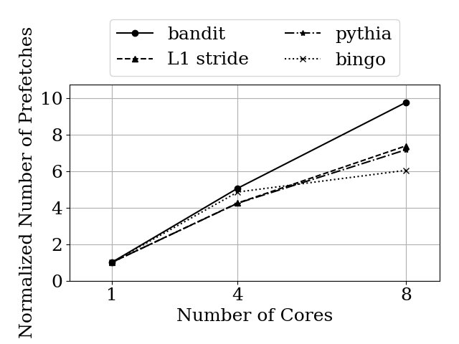
Aggressiveness Grows with Cores
Bandit becomes more aggressive when resources are scarce
Most become less aggressive when resources are scarce
Block et al., "Micro-MAMA: Multi-Agent Reinforcement Learning for Multicore Prefetching," Micro 2025

Slide 25
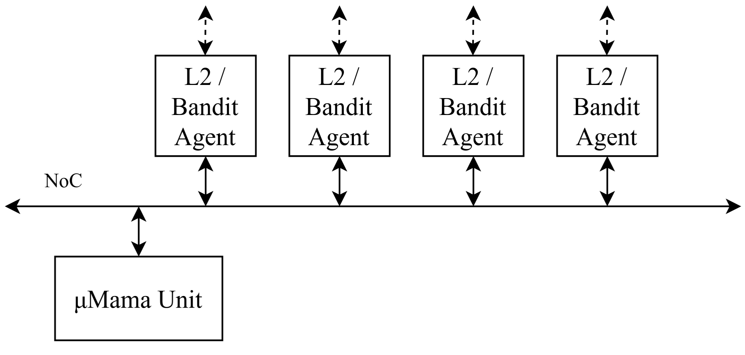
Micro-MAMA
We address this with Micro-MAMA
A central agent supervises the system
Pushes prefetcher agents towards better system-wide equilibria
Block et al., "Micro-MAMA: Multi-Agent Reinforcement Learning for Multicore Prefetching," Micro 2025

Slide 26
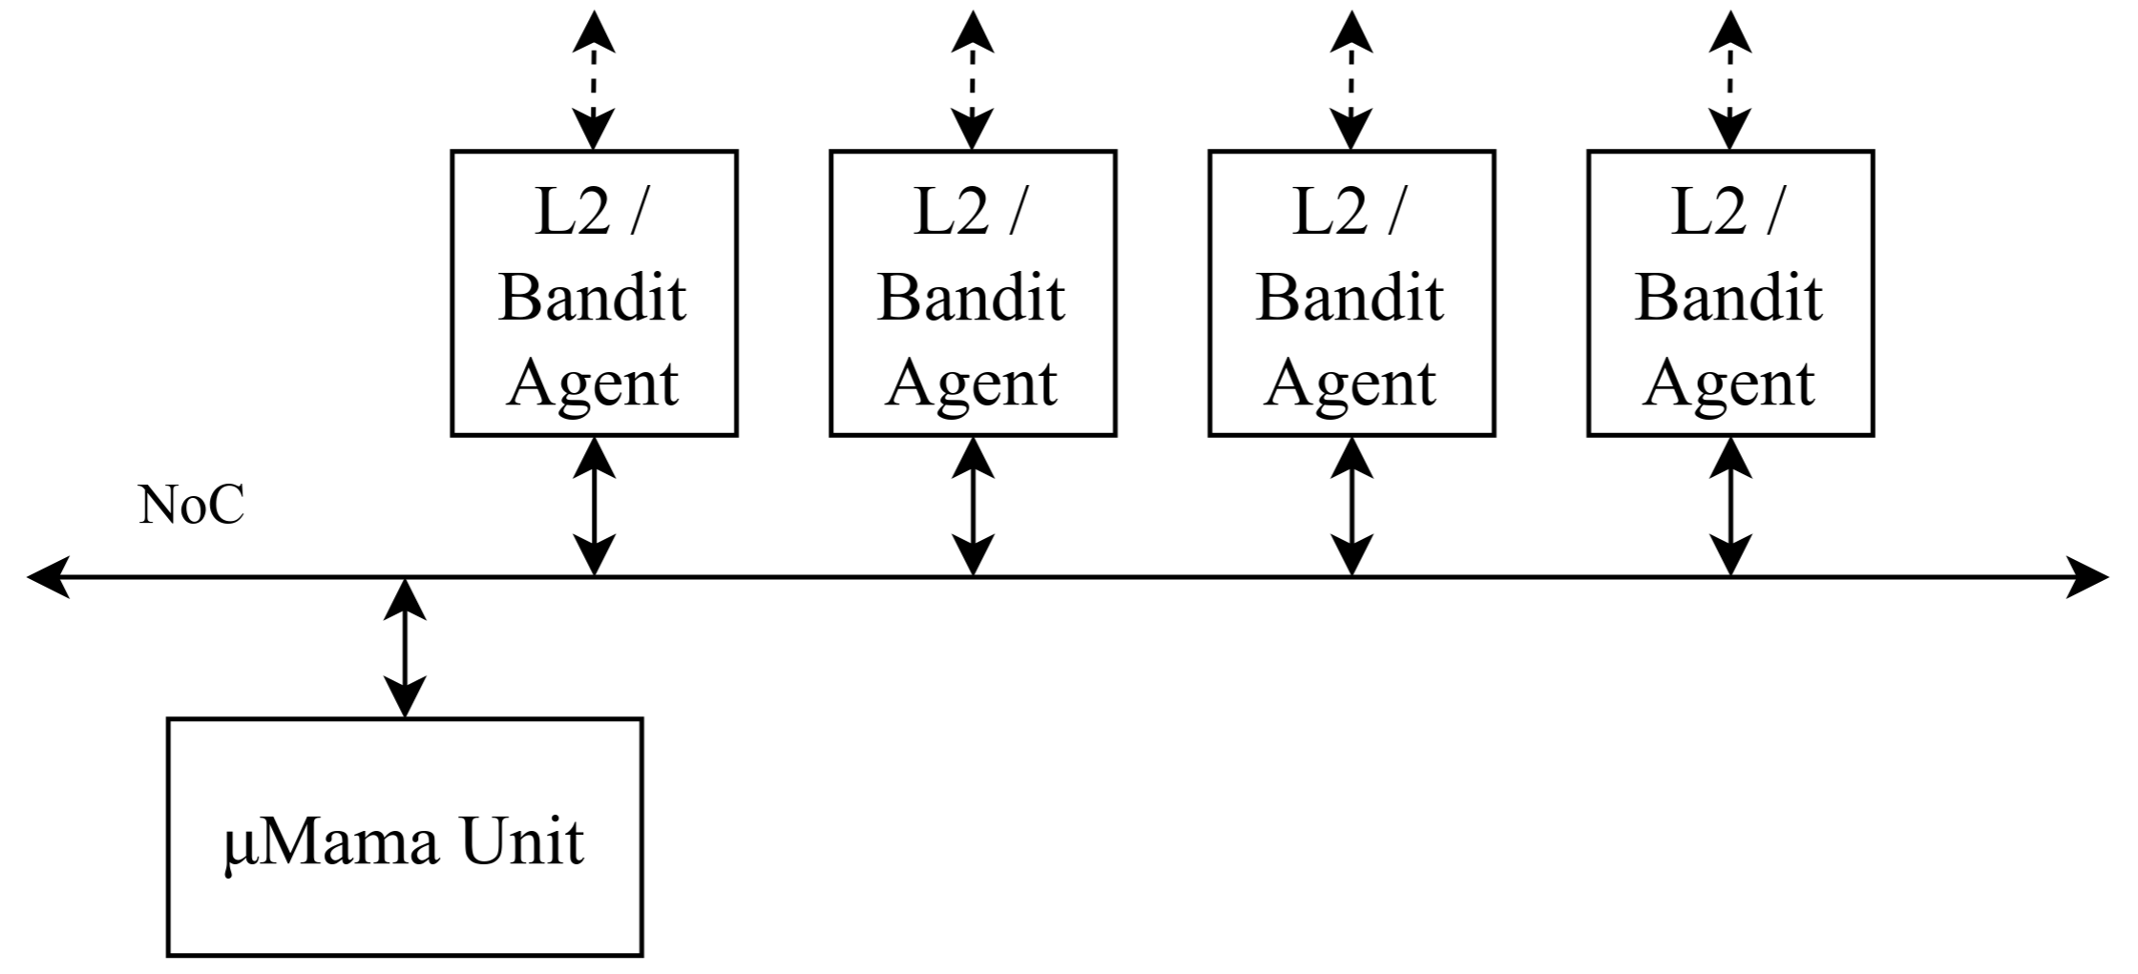
The Micro-MAMA Architecture
Config + Perf
Config + Perf
Config + Perf
Config + Perf
Measure Perf

Slide 27
The Micro-MAMA Architecture
Measure Perf
Compute System-Level Perf & Update Reward Tables

Slide 28
The Micro-MAMA Architecture
Choose New Config
Measure Perf
Compute System-Level Perf & Update Reward Tables

Slide 29
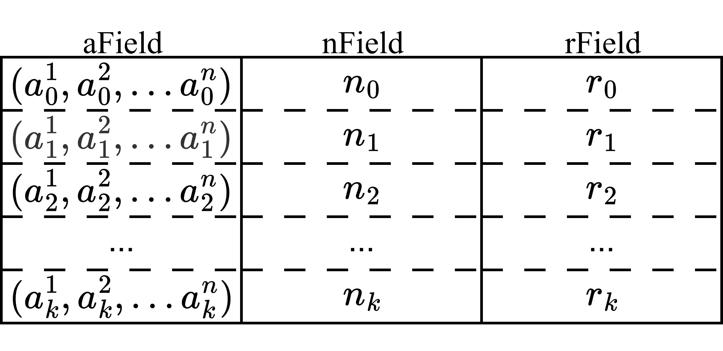
Micro-MAMA
Records joint-actions in a Joint-Action Value Cache
Which action?
How many times?
How performant?
Block et al., "Micro-MAMA: Multi-Agent Reinforcement Learning for Multicore Prefetching," Micro 2025

Slide 30
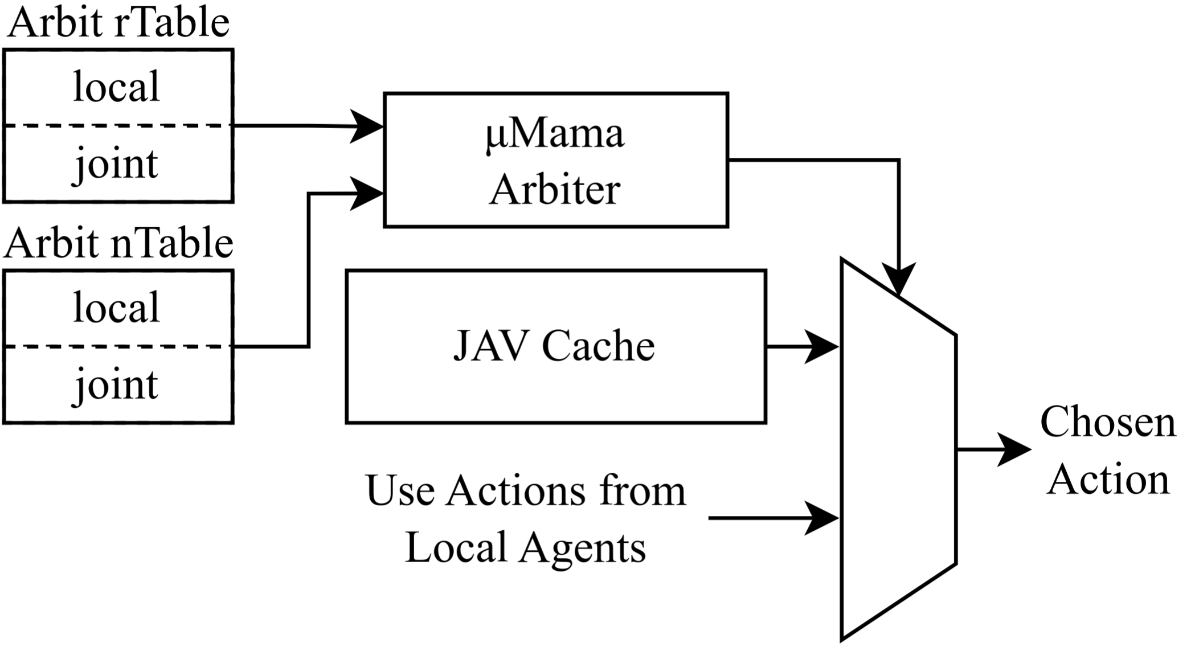
Micro-MAMA
Records joint-actions in a Joint-Action Value Cache
A Bandit-like Arbiter chooses between
Letting local prefetcher ensembles act independently
Enforcing a previously-observed joint action on all local prefetchers
Block et al., "Micro-MAMA: Multi-Agent Reinforcement Learning for Multicore Prefetching," Micro 2025

Slide 31
A New Reward Function
Ideally, the reward should be the desired performance metric
In DPC4: harmonic mean of core speedups over 1C Berti+Pythia
However, it is difficult to estimate this at runtime
How much slower does multicore make this workload?
How fast would this run if Pythia was used?
We use a simpler reward for Micro-MAMA: Geomean IPC
We also make this a small part of each local agent's reward

Slide 32

The Full Prefetcher Selection
Berti
L1
"as-is"
Next-Line
Stream
Stride
L2
SMS
BOP
LLC

Slide 33
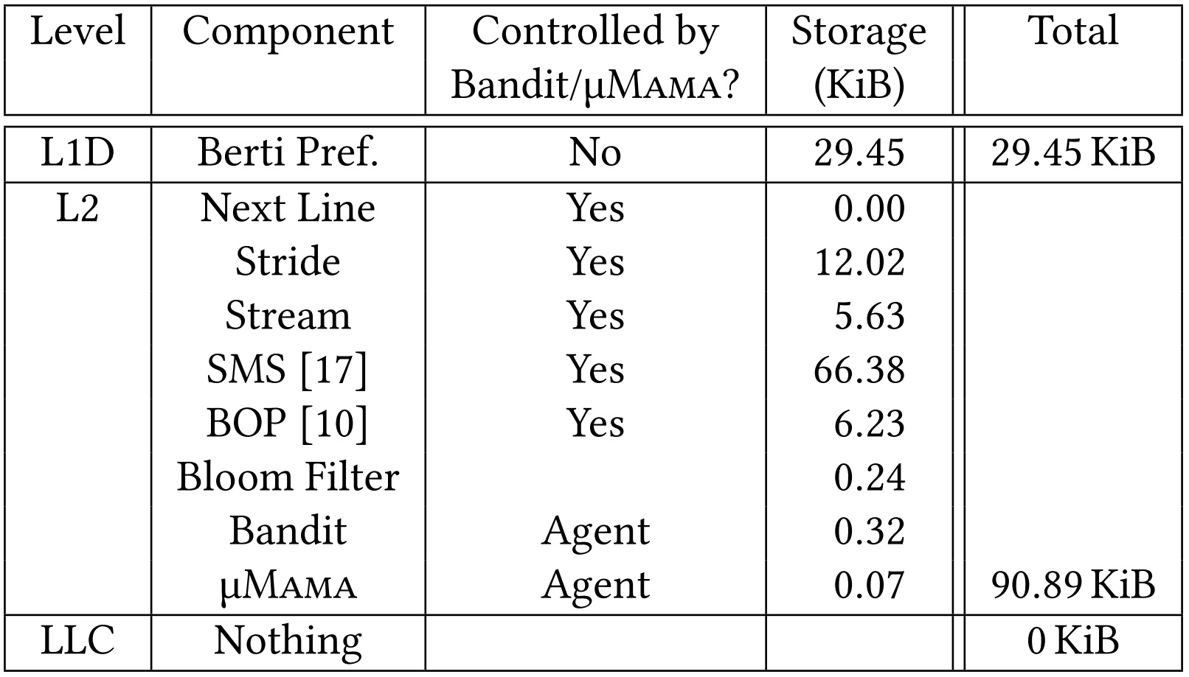
The Full Prefetcher Selection

Slide 34
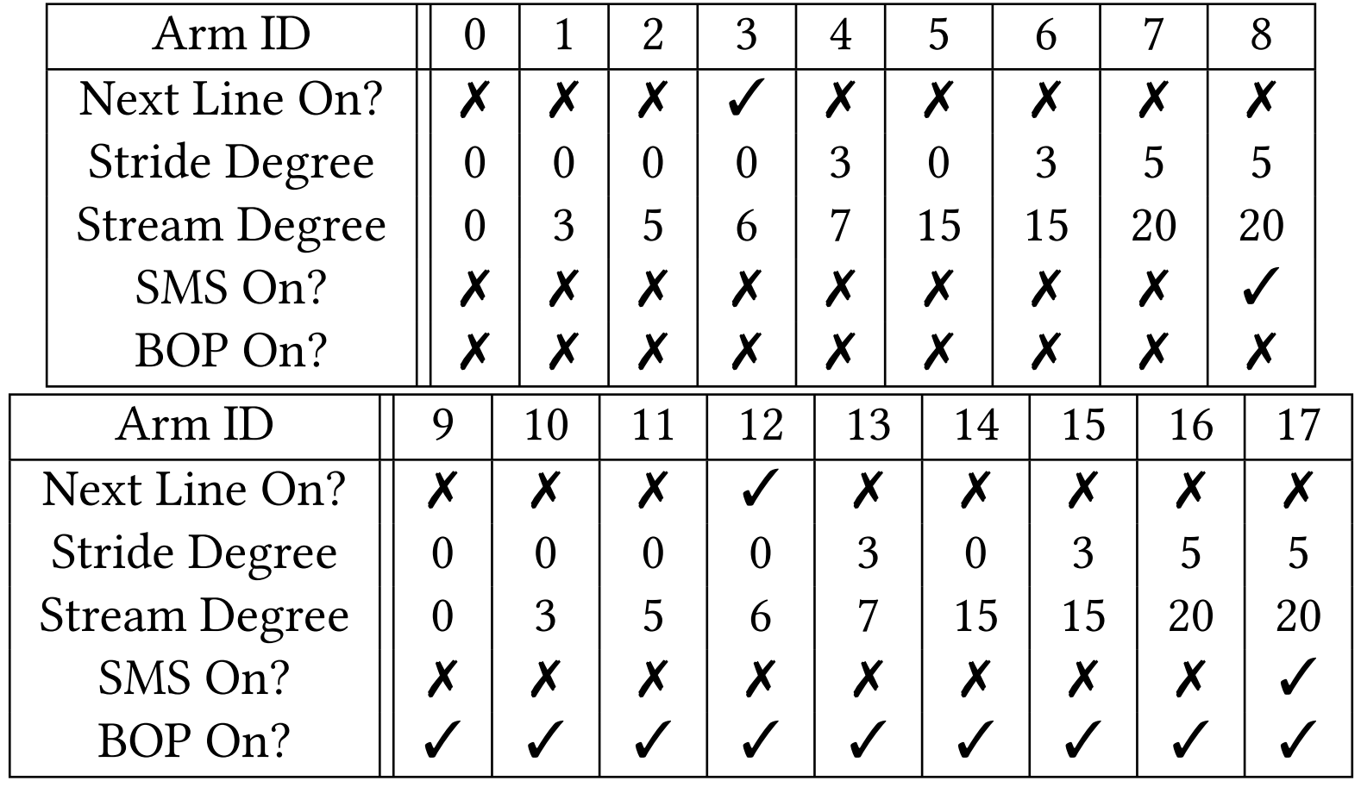
Our Arms

Slide 35
Our Arms
ON/OFF

Slide 36
Our Arms
Control prefetcher aggressiveness by varying degree

Slide 37
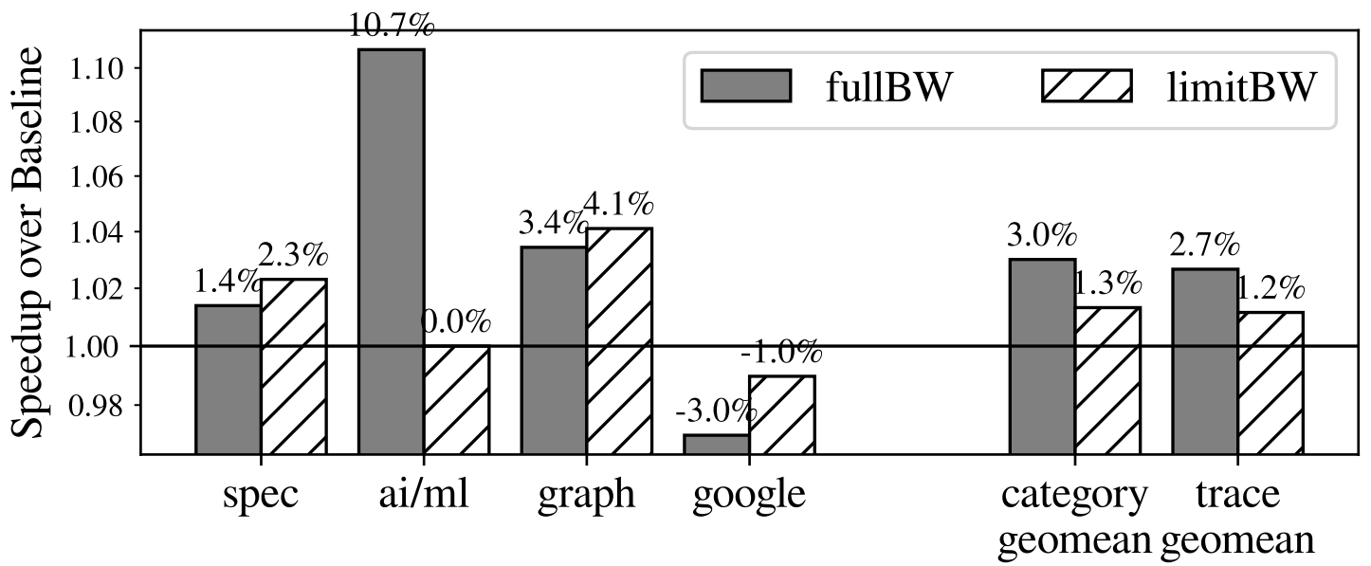
Performance
AI/ML benefits from very aggressive streaming
Sub-optimal arm selection for Google

Slide 38
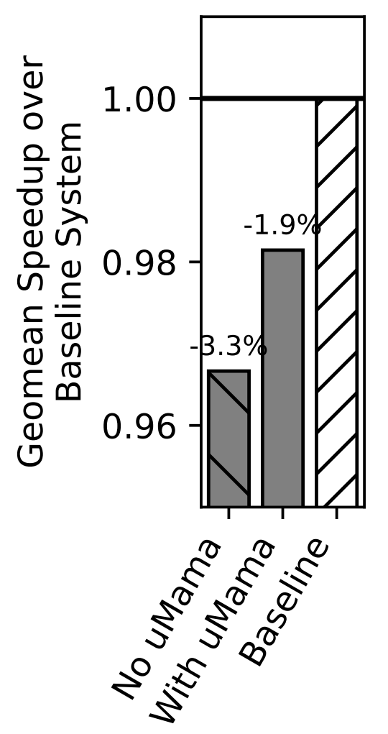
Performance
Underperform the baseline in multicore
Likely due to limited selection of low-aggressiveness arms

Slide 39
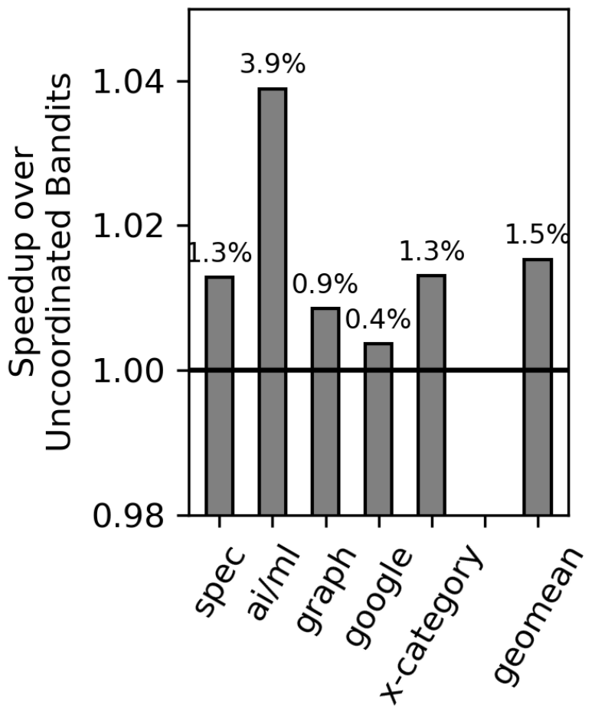
Multi-Core Benefit of Micro-MAMA
Micro-MAMA improves on Bandit in all MC categories
Without coordination, local agents over-compete for resources
Global coordination allows better resources sharing and prioritizes workloads with higher sensitivity

Slide 40
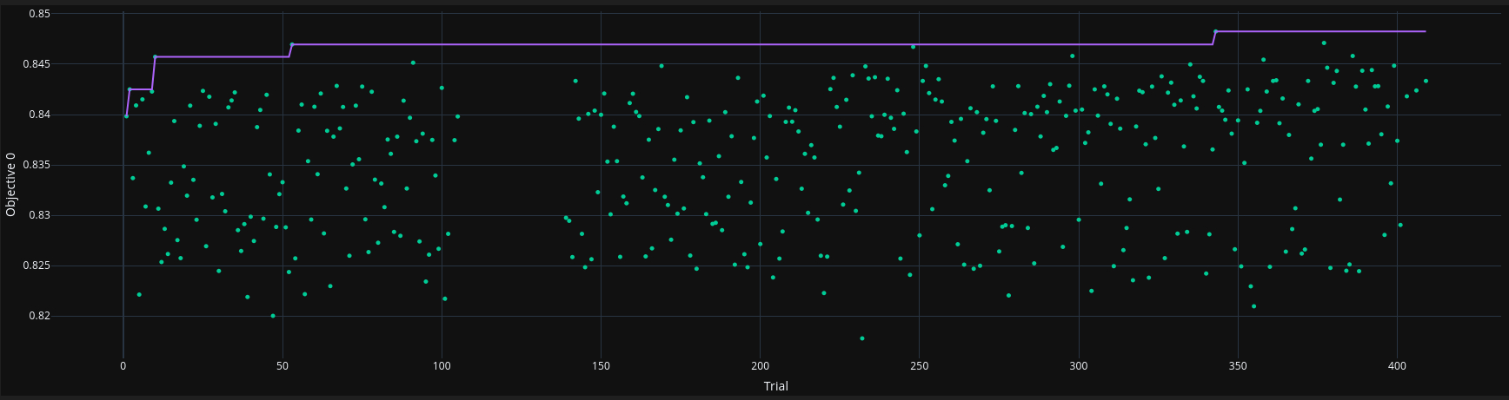
Design Space Exploration
No success at automating arm selection with
Bayesian optimization (and several similar methods)
Evolutionary algorithms
Nothing outperformed random search

Slide 41
Design Space Exploration
No success at automating arm selection with
Bayesian optimization (and several similar methods)
Evolutionary algorithms
Nothing outperformed random search
In the end, humans chose which arms to provide to Bandit

Slide 42
Design Space Exploration
We still believe that automated methods of selecting arms are necessary for achieving Bandit/Micro-MAMA's full potential
Traditional autotuning algorithms are not well-suited to the highly-categorical nature of this problem
Long simulation times (esp. multicore) make iterative processes very time-consuming

Slide 43
Conclusion
We present a performance-driven L2 prefetching solution using multi-armed bandit models for ensemble control
System-level control like Micro-MAMA is crucial for these systems to perform well in multicore
Design space exploration for these systems remains challenging and an interesting future research direction

Slide 44
Performance-Driven Composite Prefetching with Bandits
Charles Block, Pedro Palacios Almendros, Abraham Farrell, Gerasimos Gerogiannis, Josep Torrellas
University of Illinois Urbana-Champaign
coblock2@illinois.edu
February 1, 2026

Slide 46
